Slide 1
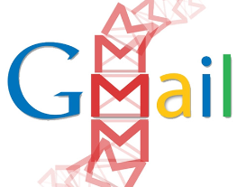
Because Gmail first
launched on April 1st
of 2004, many people
thought it was an
April Fools' Day prank.

